Slide 1



INNOVATION DESIGN LAB - CS389 2023
NAME – Ayush Sharma
ROLL NUMBER - 2101CS15

Slide 2
PROBLEM STATEMENT AND MOTIVATION
TOPIC - CRIME SCENE DETECTION USING MACHINE/DEEP LEARNING
MOTIVATION - CRITICAL NEED FOR INNOVATIVE SOLUTIONS TO ADDRESS THE ONGOING THREAT OF TERRORISM AND HOSTAGE SITUATIONS. THE LACK OF ACCURATE REAL-TIME INFORMATION IN SUCH SCENARIOS CAN HINDER THE EFFECTIVENESS OF SECURITY FORCES AND THEIR ABILITY TO RESPOND APPROPRIATELY.

Slide 3
CHALLENGES
OBTAINING A SUFFICIENT AMOUNT OF HIGH-QUALITY DATA FOR TRAINING MACHINE LEARNING MODELS IS CHALLENGING AS THE DATASET MUST ACCURATELY REPRESENT DIVERSE SCENARIOS.
TIMELY RESPONSES ARE REQUIRED SO MODELS ARE REQUIRED THAT CAN PROCESS DATA IN REAL TIME.
IMBALANCED DATASET AND MODEL COMPLEXITY .

Slide 4
CONTRIBUTIONS
DATASET COLLECTION FOR BOTH HOSTAGE AND NON HOSTAGE SCENARIOS .
COLLECTION OF CRITICAL AUDIOSETS FOR AUDIO CLASSIFICATION TOTAL 600 SAMPLES COLLECTED.
ERANNs - EFFICIENT RESIDUAL AUDIO NEURAL NETWORK IMPLEMENTATION USING TENSORFLOW.
TRAINED THE AUDIO NETWORK ON THE COLLECTED AUDIO DATASET AND AUDIO FEATURES EXTRACTION.
EXTRACTED KEYPOINTS OF THE COLLECTED DATASET FROM YOLO POSE AND ALPHAPOSE MODEL FOR GROUPFORMER.

Slide 5



INTRODUCTION OF ERANN
we use the log mel spectrogram as input to the first 2D convolutional layer.
The batch normalization layer after the feature extractor is used as a replacement for data standardization.
Each tensor between convolutional blocks has a shape of Fi × Ti × Ci, where
Fi - “the ith frequency size”
Ti is “the ith temporal size”
Ci is the number of channels.
All input tensors after feature extraction have a shape of F0 × T0 × C0, where F0 = M = 128, T0 = Ts, and C0 = 1 .
We modify sizes of kernel, stride, and padding for the temporal dimension in few convolutional layers to make models faster.

Slide 6
ERANN-SM − W
sm - the decreasing temporal size parameter.
for sm > 0, temporal sizes Ti are reduced stronger based on increased stride sizes of convolutional layers hence reduce FLOPs of our models
W - the widening factor for the width of convolutional layers to change the computational complexity of models
A
B

Slide 7
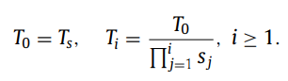
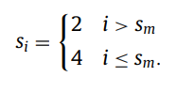


ARB ARCHITECTURE
Stride sizes si for i = 1, . . ., 3 for convolutional blocks ARB(2, si, c) can be calculated as
Temporal sizes Ti for i = 0, . . ., 3 are calculated as
ARB(x, y, c) is “the Audio Residual Block”, where x is the stride size for the frequency dimension, y is the stride size for the temporal dimension, and c is the number of output channels.

Slide 8
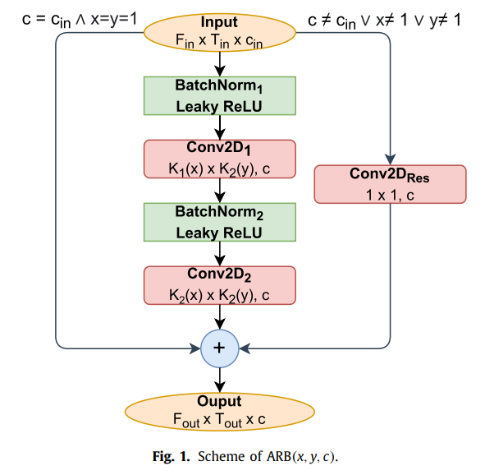
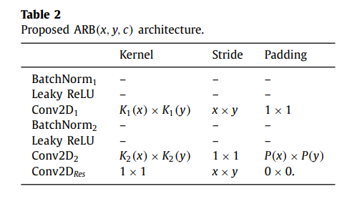
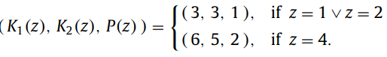
AUDIO RESIDUAL BLOCK ARCHITECTURE

Slide 9
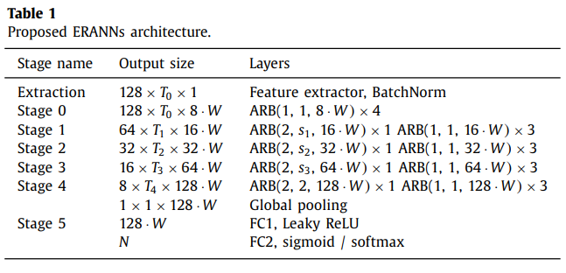
ERANNS ARCHITECTURE

Slide 10
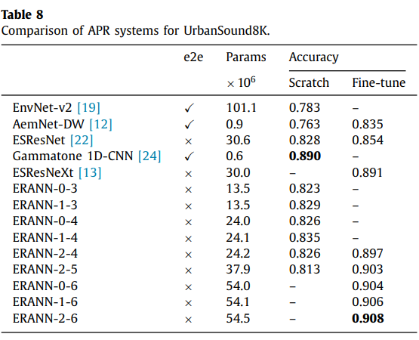
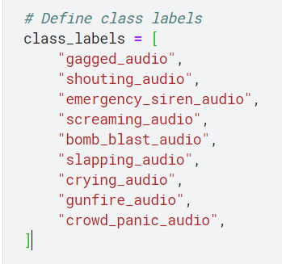

ERANN-2-6 achieves an accuracy of 0.908, which is better than the performance of the previous best system with an accuracy of 0.891. Moreover, ERANN-2-4 with an accuracy of 0.897 outperforms the previous state-of-the-art system and is 1.24x smaller. We have obtained an accuracy of 84.4% on urbanSound8k and an accuracy of 81.9% on our own dataset.
RESULTS COMPARISION

Slide 11
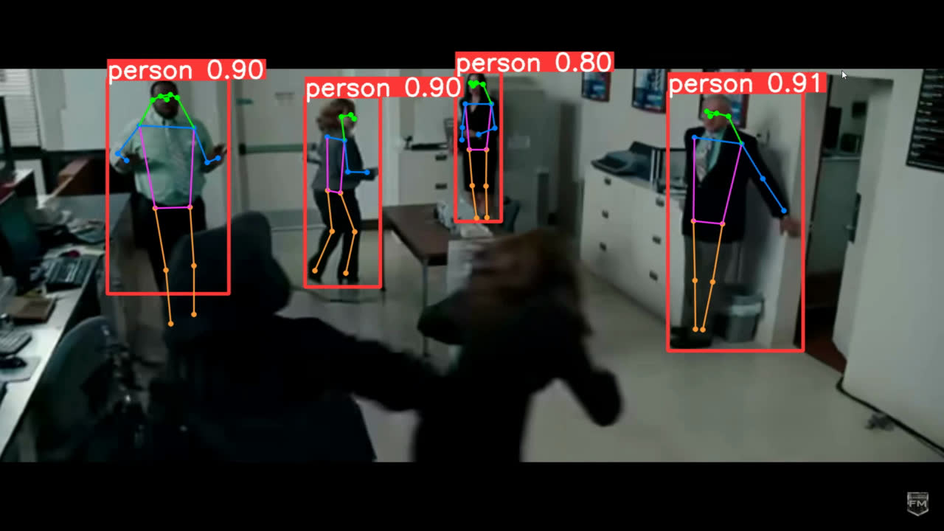
KEYPOINTS

Slide 12
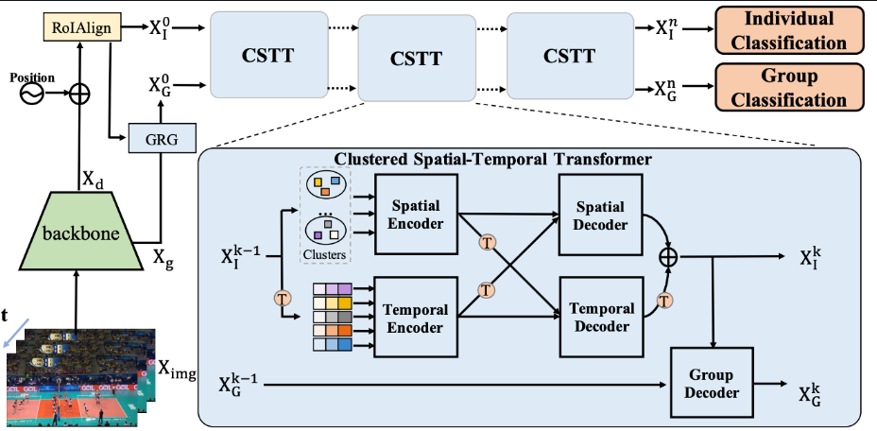
GROUPFORMER

Slide 13
THANK YOU!

